Slide 1
Exploring Web Development HTML, CSS, JS and Git
By Batul Rawat

Slide 2
Table of contents
HTML
Javascript
01
03
CSS
Git Basics
02
04
Basic tags and formats
Writing beginner-level scripts
Using various selectors, attributes to design
Uploading projects on Github

Slide 3
Prerequisites
Download VS Code
Explore Extensions - download Live Server, Prettier, Github extension
Download github desktop (optional)

Slide 4
HTML!
Knowing the basic tags and writing a HTML script

Slide 5
Introduction
HTML - HyperText Markup Language
Mainly used for designing web pages using various tags

Slide 6
Popular Tags
html | Main tage that tells the doc is html | body | Contains the main content
head | Contains title, links, etc | nav | top-most part of any web page
title | Displayed in the title bar | <hn> | Heading tag where n=1 to 6
link | Linking stylesheets, fonts and icons | p | Paragraph tag
meta | Displays metadata of the HTML file | a | Anchor tag to include links
script | Used to include JS for functionality | img | Used to include images

Slide 7
Popular Tags
br | Used to break line & go to the next | ul | Unordered list
hr | Creates a horizontal line | ol | Ordered list
em | Bold + italics | li | List item
table | Used to create a table | tr | Table row
th | Table header | span | For designing purpose - inline
td | Table data - fills columns | div | Creates various divisions of blocks

Slide 8
Quick Notes
In HTML, each element (aka tag) has attributes which have values associated with them.
Examples: <img src=”xyz.jpg” alt=”XYZ”/>
<a href=”www.google.com”> Google </a>
<p style=”color:red; font-size: 10px;”>
<html lang=”en-US”>

Slide 9
CSS!
Learning the various attributes and their values corresponding to the many tags

Slide 10
Introduction
CSS - Cascading Style Sheets
Required to enhance a web page and design the tags in HTML
Format:- tag {
property1: value1; …
propertyN: valueN;
}

Slide 11
Three ways to link CSS
Inline
Internal
External
Using the style attribute inside the HTML tags
<img src=”color.jpg” style=”border: 4px solid #000; width: 200px” />
Using the <style> tag in the <head>.
<style>
h1{
color: red;
} …
</style>
Linking an external stylesheet, done using <link> tag.
<link rel= “stylesheet” href=”style.css” />

Slide 12
Popular Attributes
color | border
font-size | width
font-family | height
background-color | float
margin | text-align
padding | display

Slide 13
Popular Attributes
transition | border-radius
text-transform | box-sizing
text-decoration | position
letter-spacing | opacity
outline | z-index
list-style-type | Math funcs - ()

Slide 14
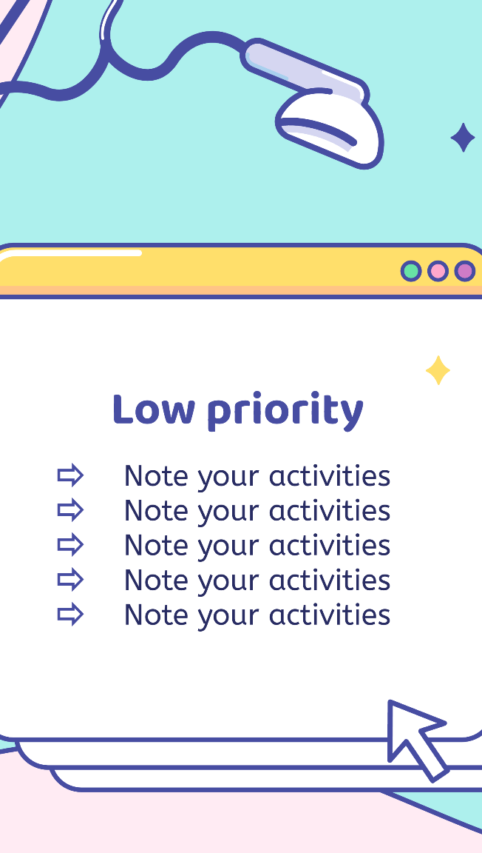
Smartphone
To change the view sizes of a website, we use the media queries available in CSS.
Eg: @media (max-width:480px){
…..
}

Slide 15
JS!
Writing functions for interactivity

Slide 16
About
JS - Javascript
Helps in making the web page interactive by adding functionality to it

Slide 17
Variables – var, let, const
Functions – arrow or normal
In-built functions
Window functions
Etc…

Slide 18
GIT!
A way to showcase or collect all your projects in a single framework

Slide 19
Ways to upload projects on Github
Using the Git extension
Using the Git Desktop
There are more ways…
Using the extension in Visual Studio code, we can directly attach it to a repository and commit and push changes.
Connecting the account to the git desktop application and pushing and pulling the origin and committing the changes.

Slide 20
HANDS-ON TIME!!

Slide 21
Resources to explore more…
W3schools.com | https://w3schools.com/
MDN docs | https://developer.mozilla.org/en-US/
Codepen | https://codepen.io/
Coursera | https://www.coursera.org/
Github | https://github.com/
Youtube | https://www.youtube.com/

Slide 22
To-do application
Add your to-do things in the list

Slide 23
Javascript Calculator
Take inputs and calculate and display the result

Slide 24
Mode-changes
Change to light and dark mode

Slide 25
Parallax Website
https://www.w3schools.com/howto/tryhow_css_parallax_demo.htm

Slide 26
Personal Portfolio
Mini resume - https://kiruba-r11.github.io/Glassmorphic-Profile-Card/

Slide 27
Drag-N-Drop
Drag an image and drop it in the box or anywhere

Slide 28
Sticky Notes
Similar to To-do application

Slide 29
Hex-Color Gradient
Random gradient generation

Slide 30
Creative Login Form
Create a fine UI for a login form (register form)

Slide 31
Photo Gallery
Make a gallery with at least 10 images

Slide 32
Landing page - I

Slide 33
Landing page - II

Slide 34
Landing page - III

Slide 35
Landing page - III

Slide 36
Guess the Color
Generate RGB colors and choose the correct color based on rgb values

Slide 37

ANY QUESTIONS?
Bcoz… Asking questions is the best way to start learning!!

Slide 38
Thank You!
CONTACT
19cs137@psgitech.ac.in
+91 9362138711
https://www.linkedin.com/in/batul-rawat/
Learning never ends! So keep going!! All the best!!!

